Slide 1
Analysis of Correlation Between Smoking/Drinking and Cancer
By Cesar De Paula, Angel Zuniga, and Daniel Pasion

Slide 2
Agenda
Introduction
Cancers relating tobacco and smoking
Cancers relating alcohol and drinking
Drinking and cancer beyond the U.S.
Challenges & Solutions
Conclusion
Code

Slide 3
Problem Statement
Both smoking and drinking have a long history.
Research in the recent century has demonstrated the health risks linked to smoking and drinking
Despite in the amount of research gone into proving this causal relationship, many people today still practice these habits
Bring more awareness to this correlation

Slide 4
Effects
Smoking
Inhaling cigarette smoke will start to thicken the blood in the body and damage the air sacs found in lungs that allow one to breathe.
Drinking
Once consuming alcohol, the body breaks it down as Acetaldehyde, damages DNA and prevents the body from repairing itself.

Slide 5
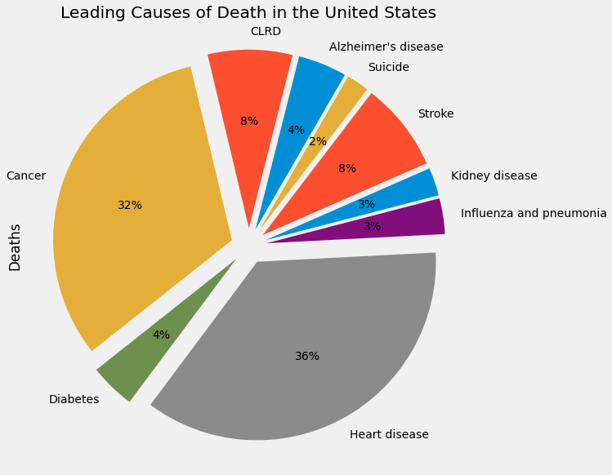
Why We Chose This Topic
Much research has shown that such behaviors may even be a direct cause for fatal diseases such as lung cancer and heart disease.

Slide 6
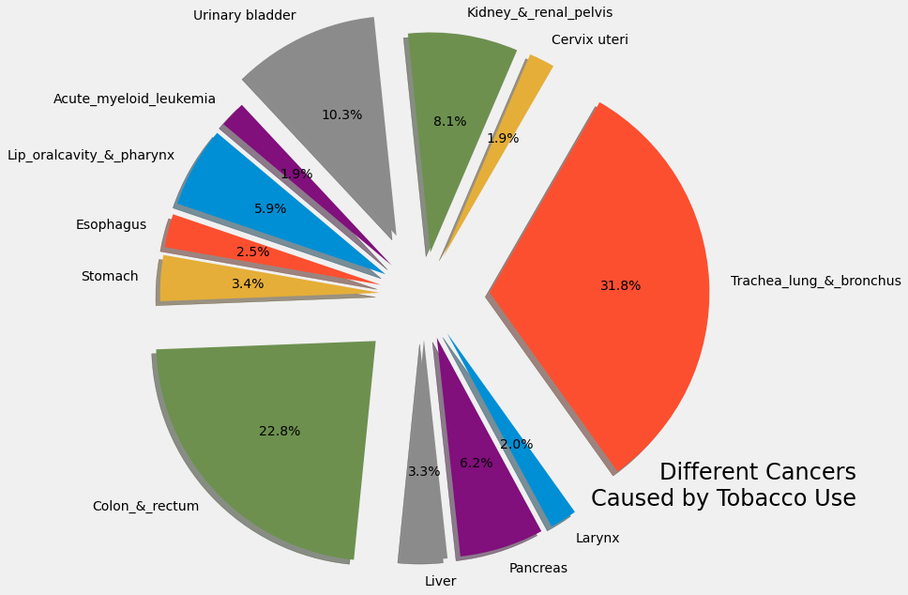
Cancers Caused Tobacco (US)
Lung cancer being the most predominant. We will focus on that.

Slide 7
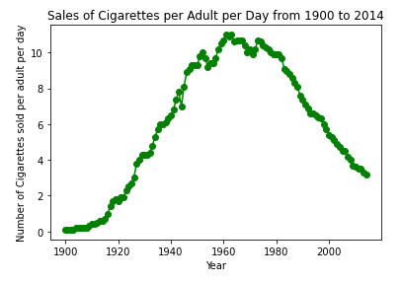
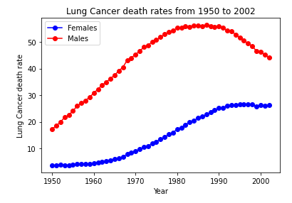

Slide 8
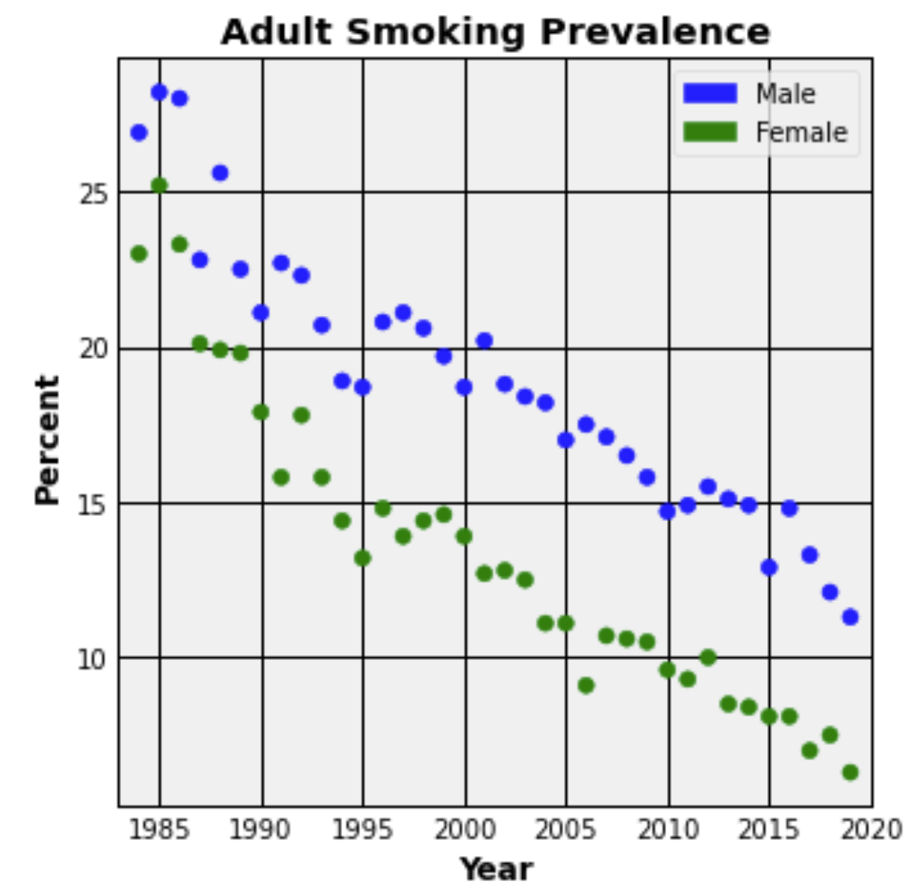
Prevalence
Smoking prevalence has steadily declined between genders.

Slide 9
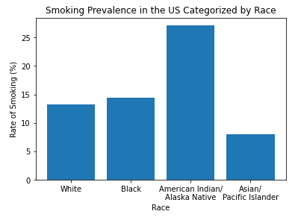
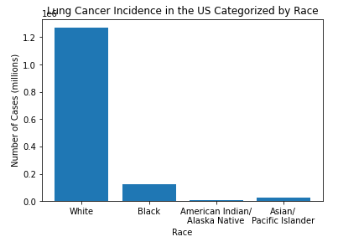

Slide 10
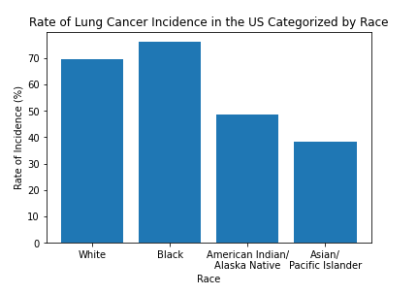

Slide 11
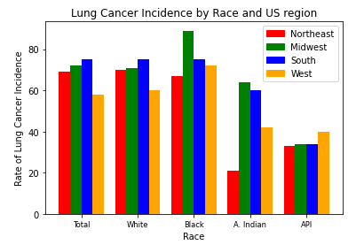
Effected Parties
Although, smoking has become less prevalent, lung cancer incidences are still common.
Disparity among various ethnicities.

Slide 12
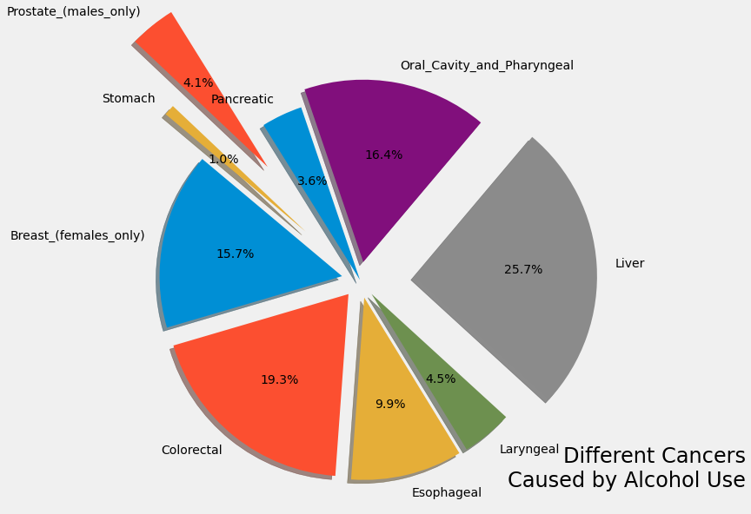
Cancers Caused by Alcohol (US)

Slide 13
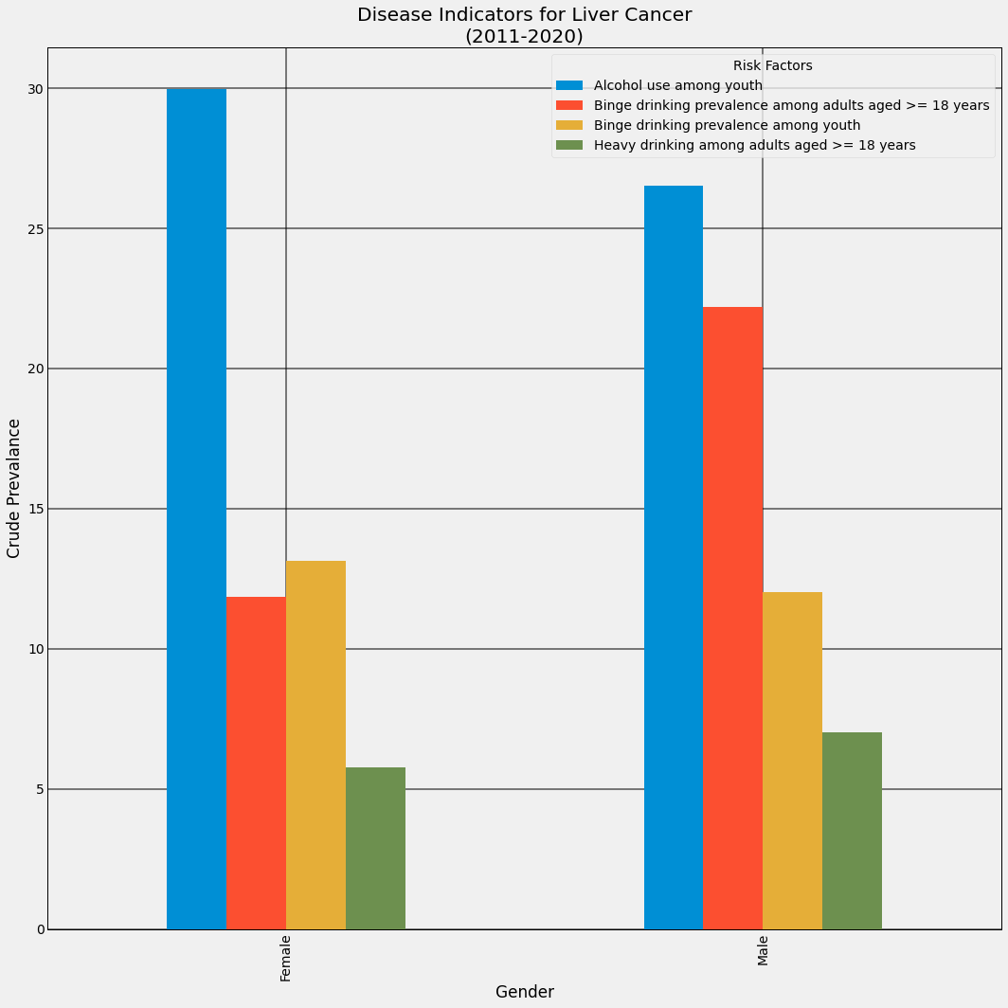
Disparities in Gender

Slide 14
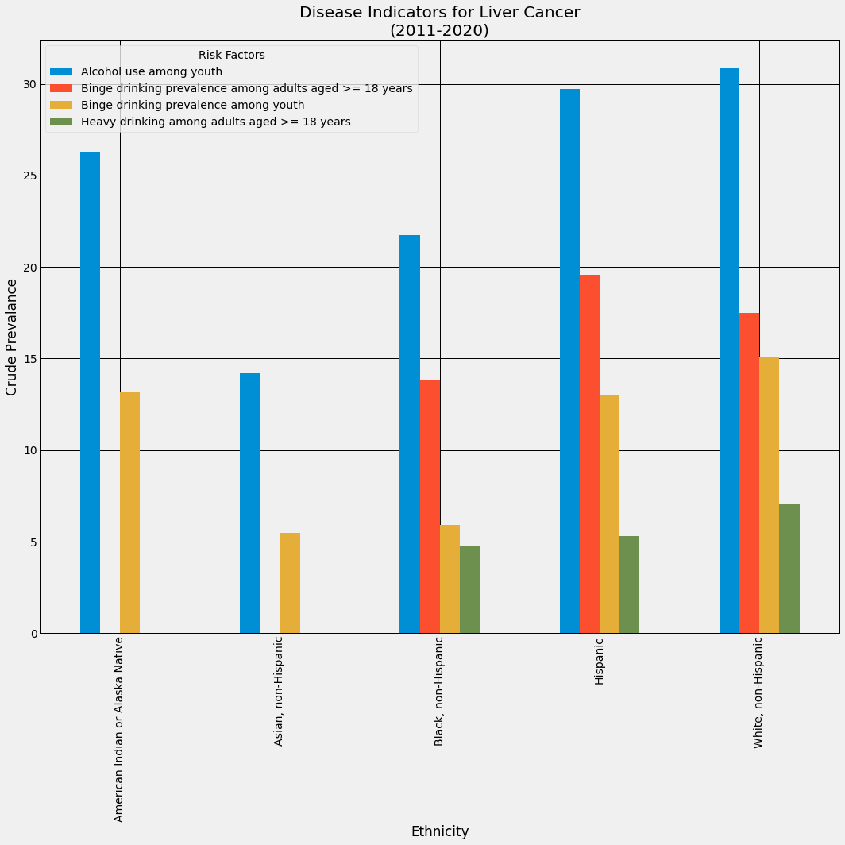
Disparities Between Ethnicities

Slide 15
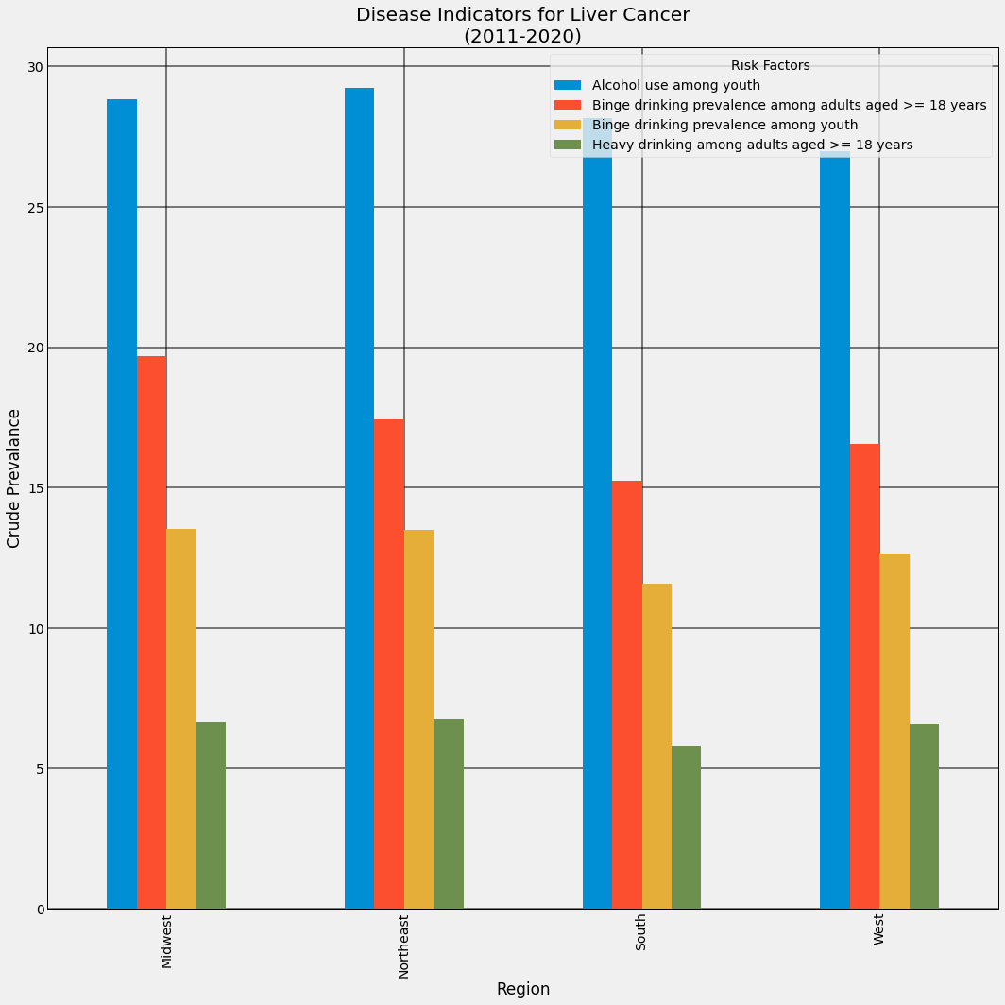
Disparities in Region

Slide 16
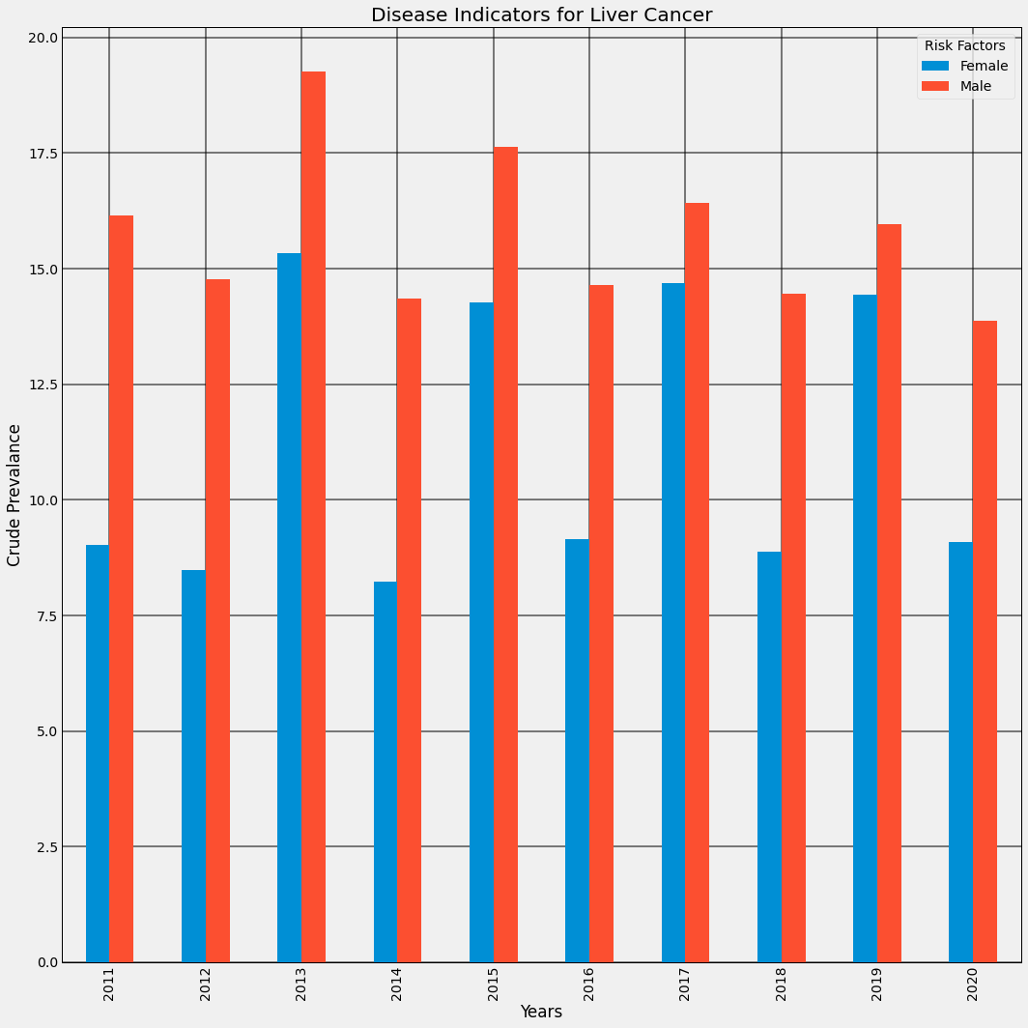
Gender Correlation in Liver Cancer Deaths

Slide 17
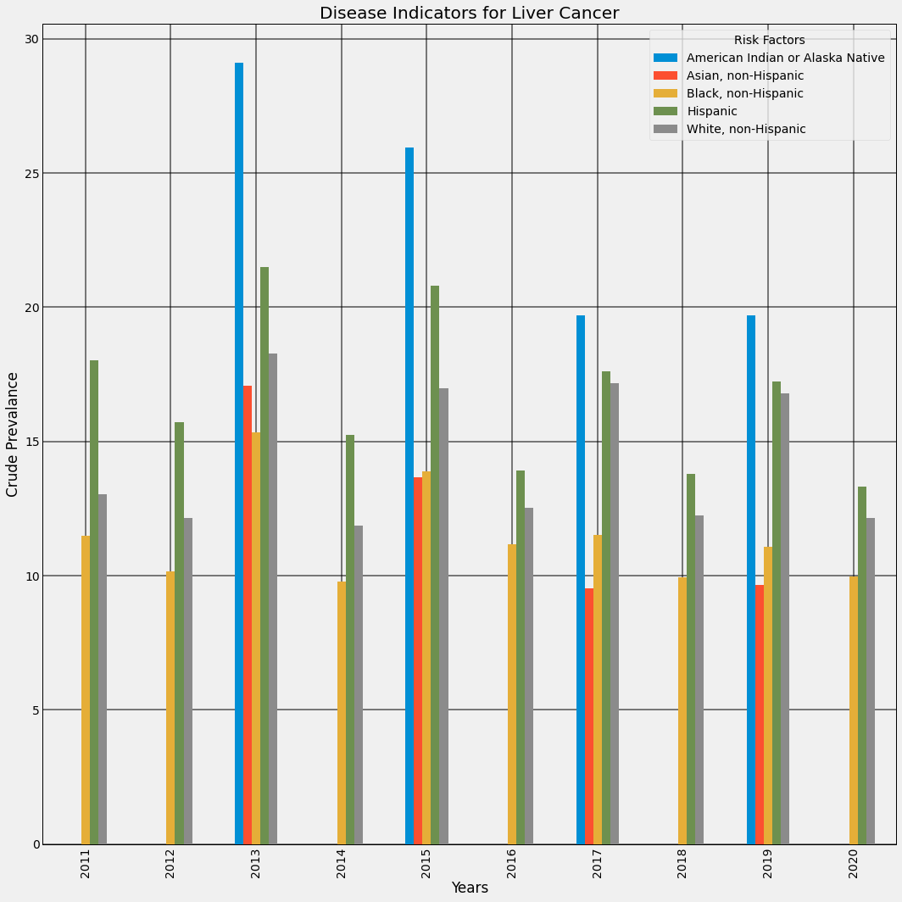
Ethnicity Correlation in Liver Cancer Deaths

Slide 18
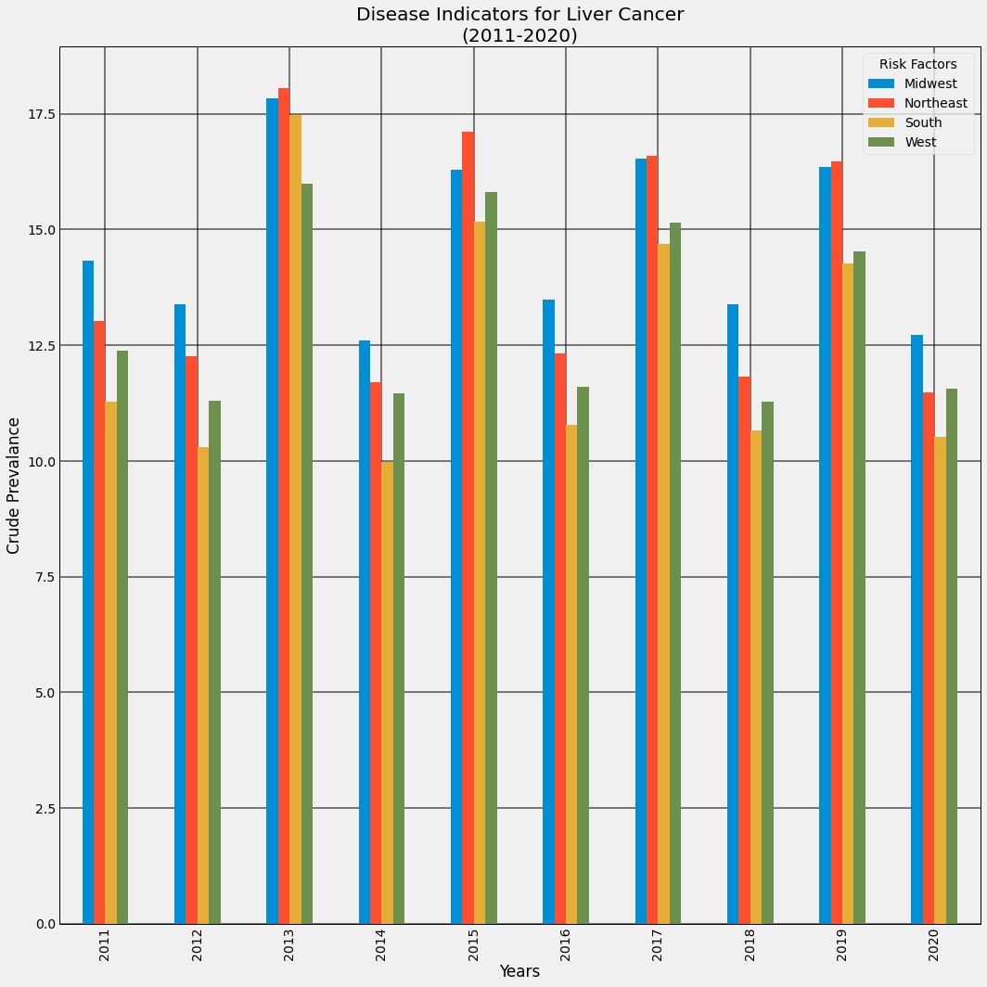
Region Correlation in Liver Cancer Deaths

Slide 19
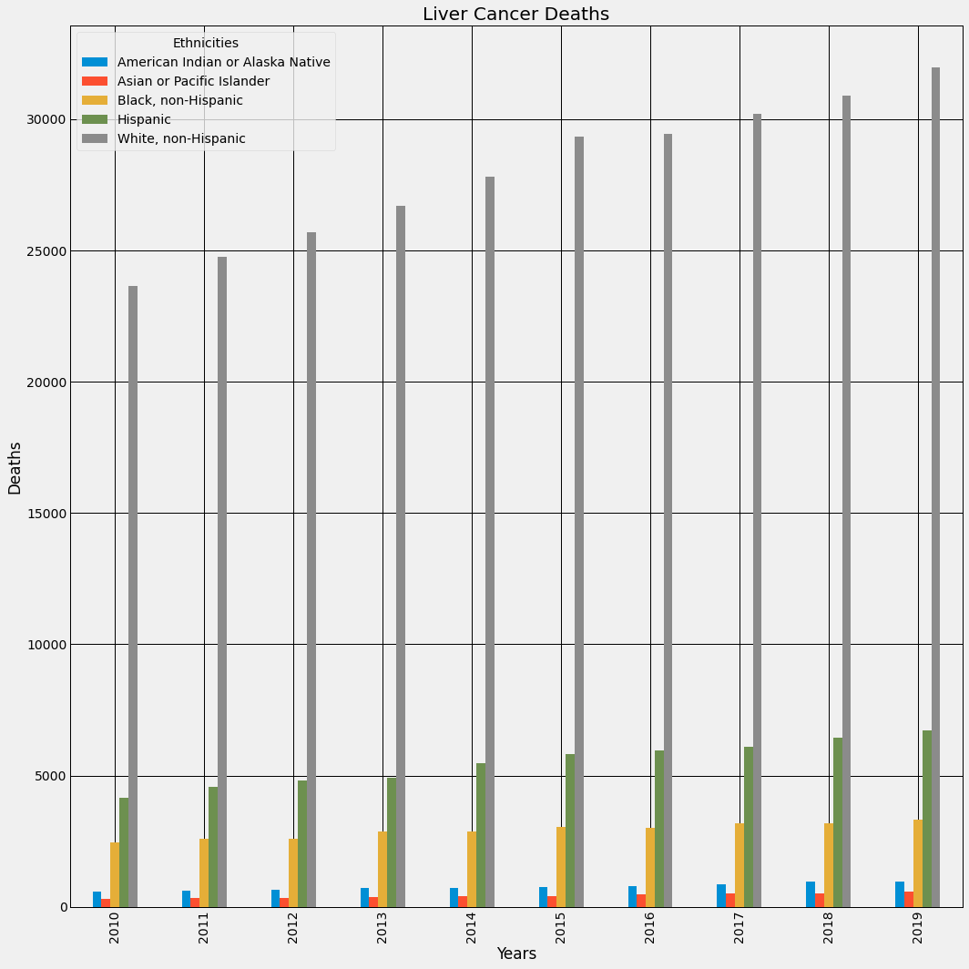
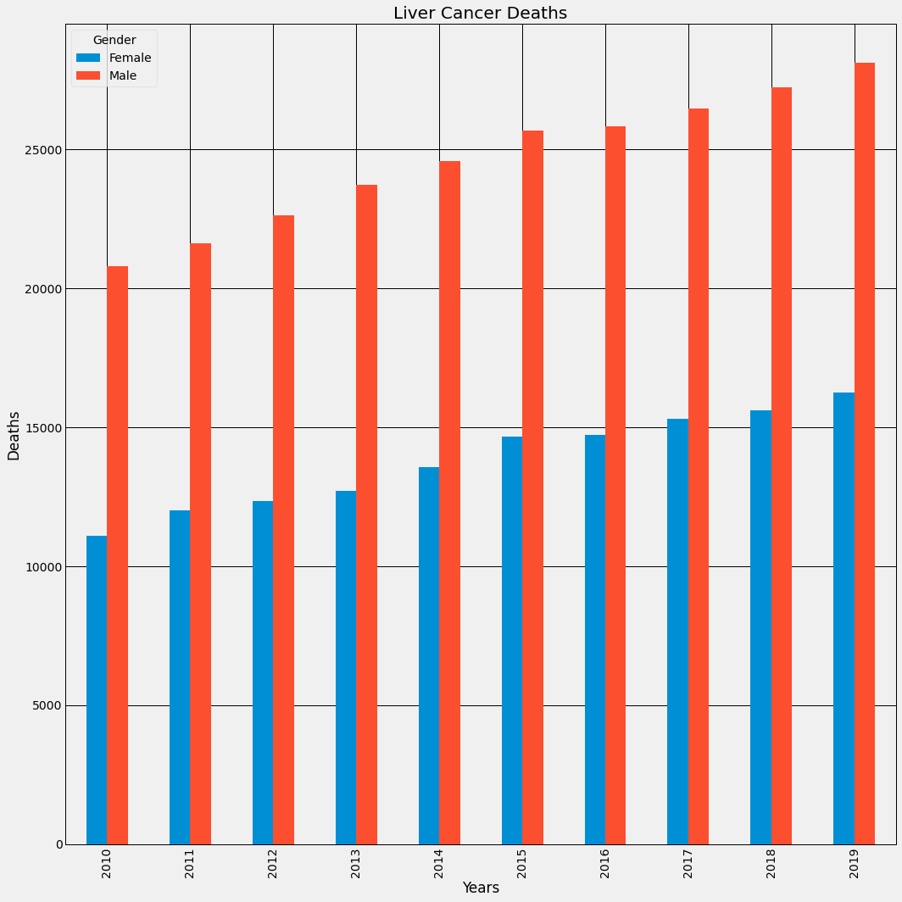
Effected Parties

Slide 20
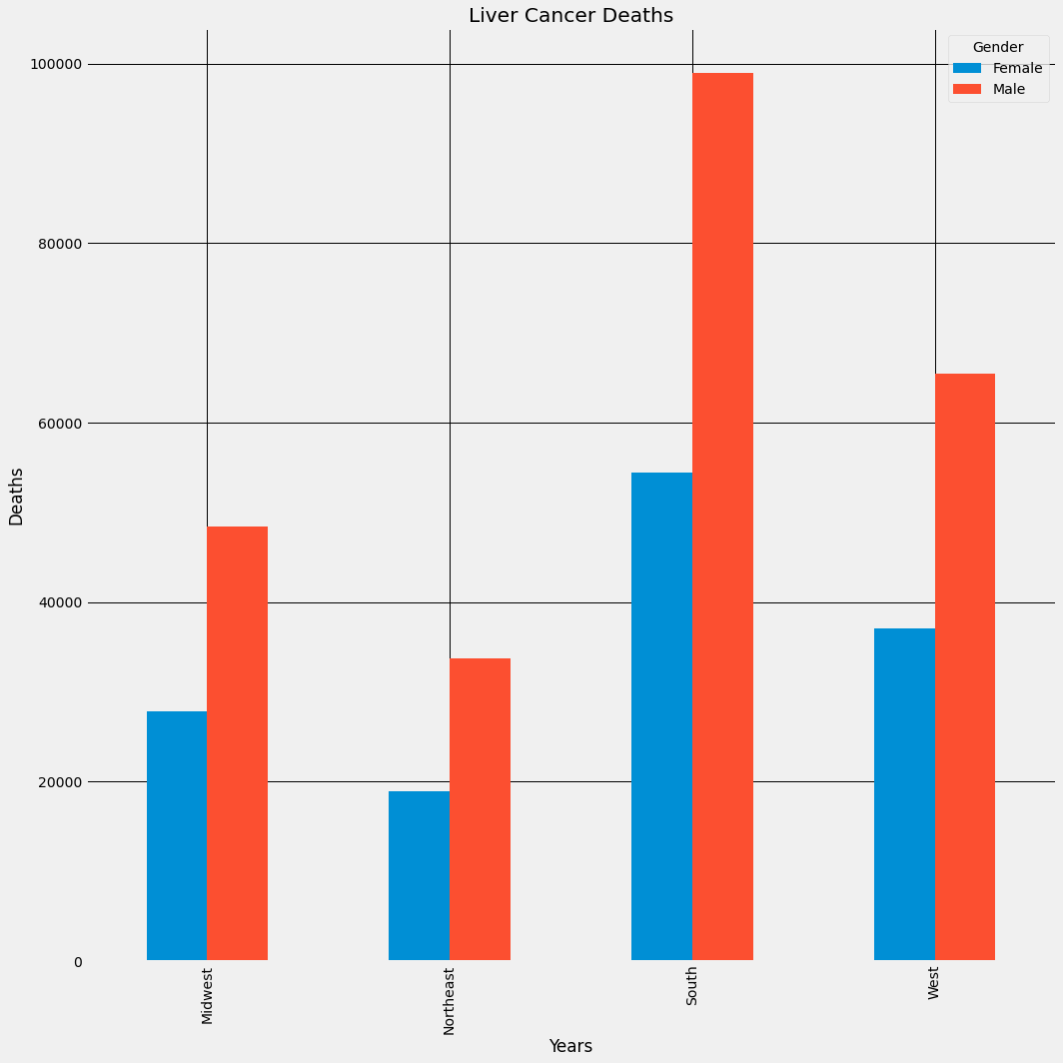
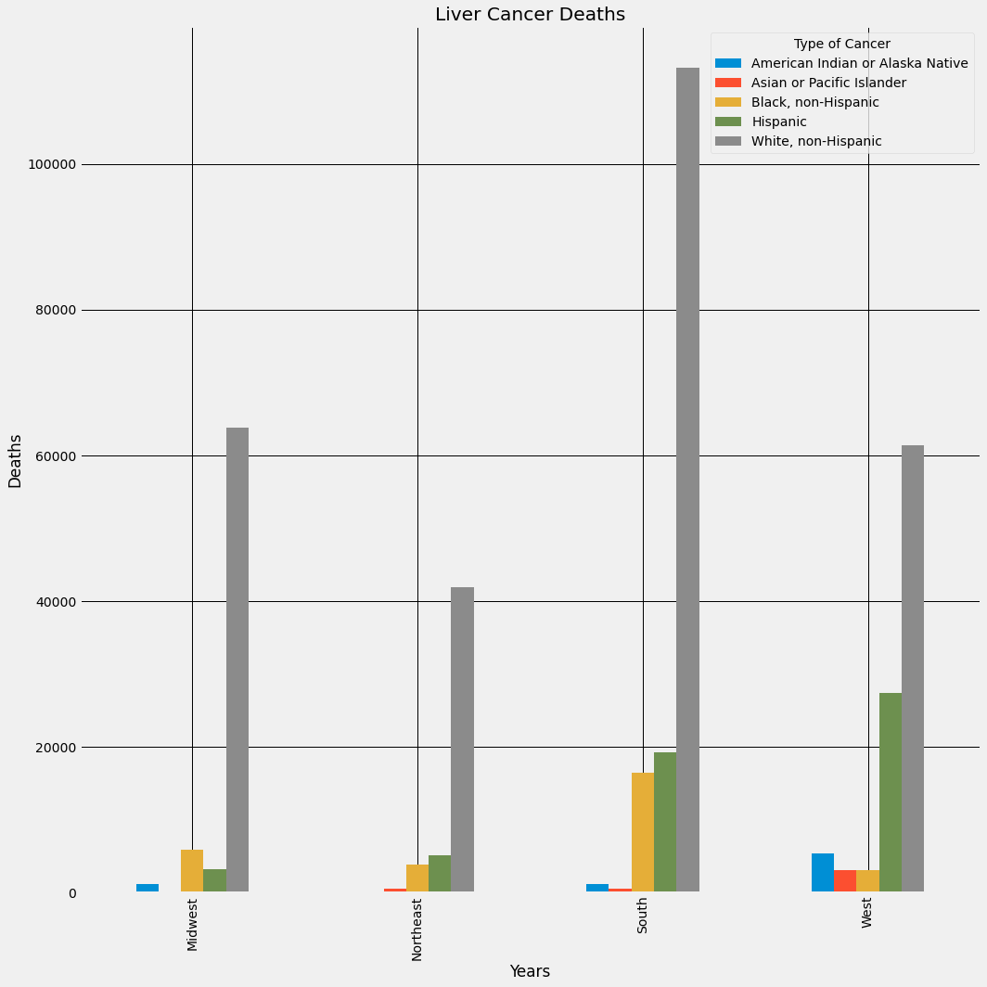

Slide 21
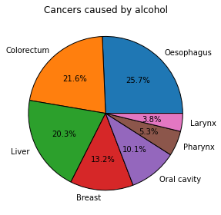
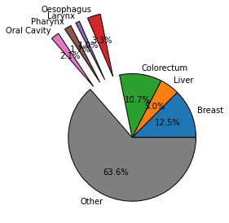
Cancer v alcohol at a global scale

Slide 22
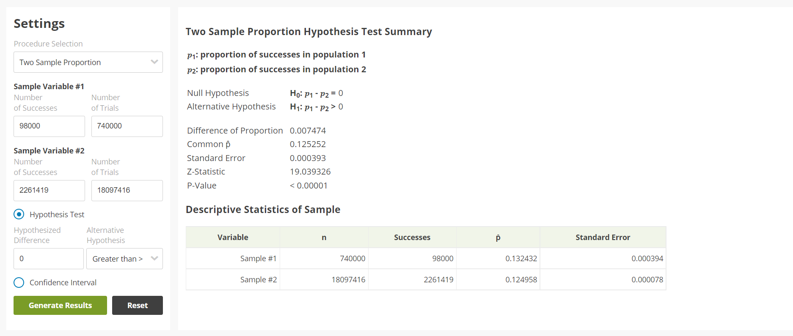

Slide 23
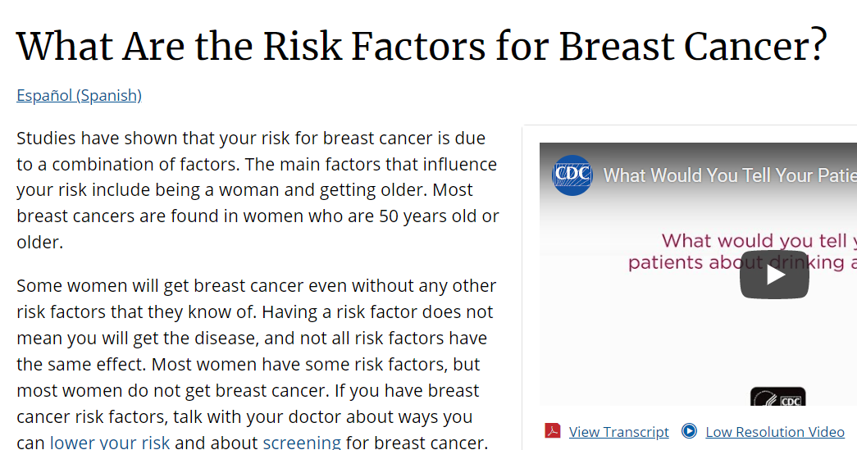
Reasoning

Slide 24
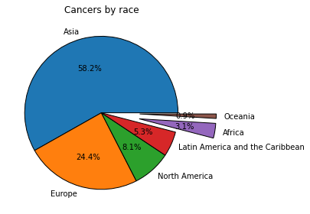
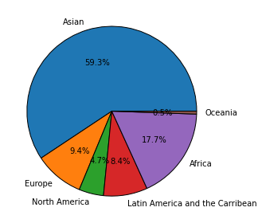



Cancer rates by continent
Population by continent

Slide 25
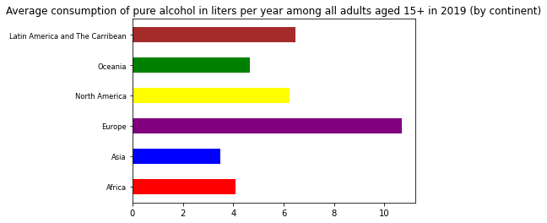
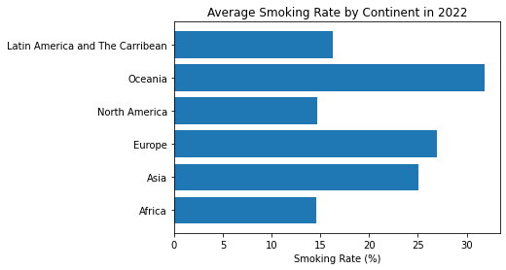
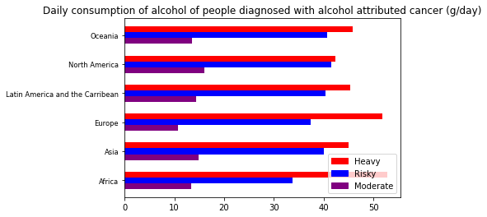

Slide 26
Challenges & Solutions
Implementing keywords and utilizing public data archives.
Developed a task schedule between group members.
We addressed the datasets that were found for smoking and drinking consumption but decided to focus on the United States as our region of focus.
Finding adequate dataset.
Schedule conflicts between group members
Datasets for smoking and drinking attributed cancers around the world were nonexistent.

Slide 27
Conclusion
It has been established numerous times that drinking and smoking will always increase the risk of getting cancer and the data we found in this project fully supports this well known claim.

Slide 28
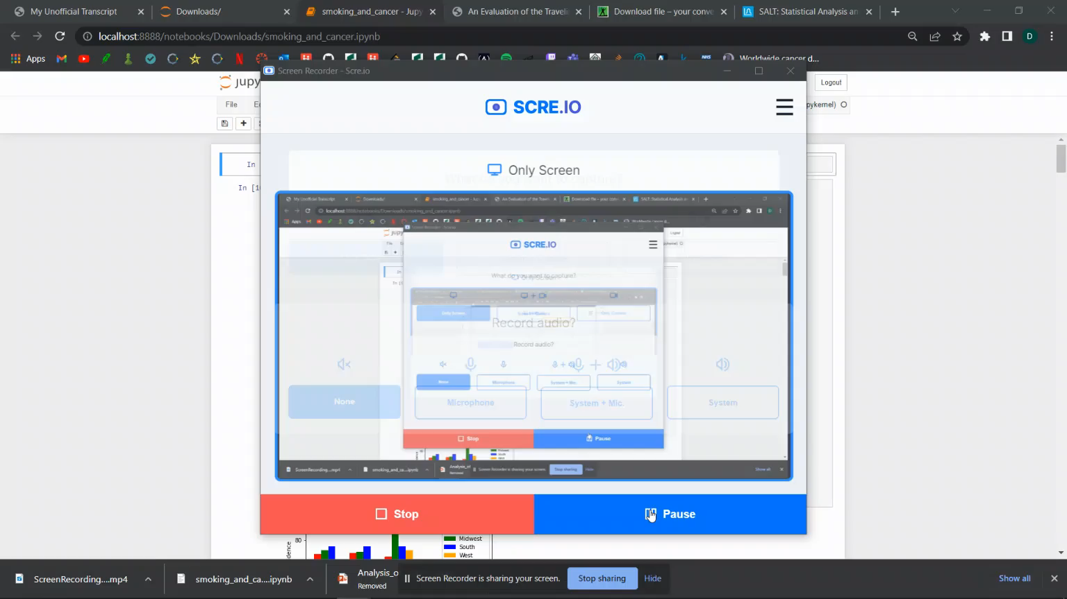
Code: Cesar

Slide 29
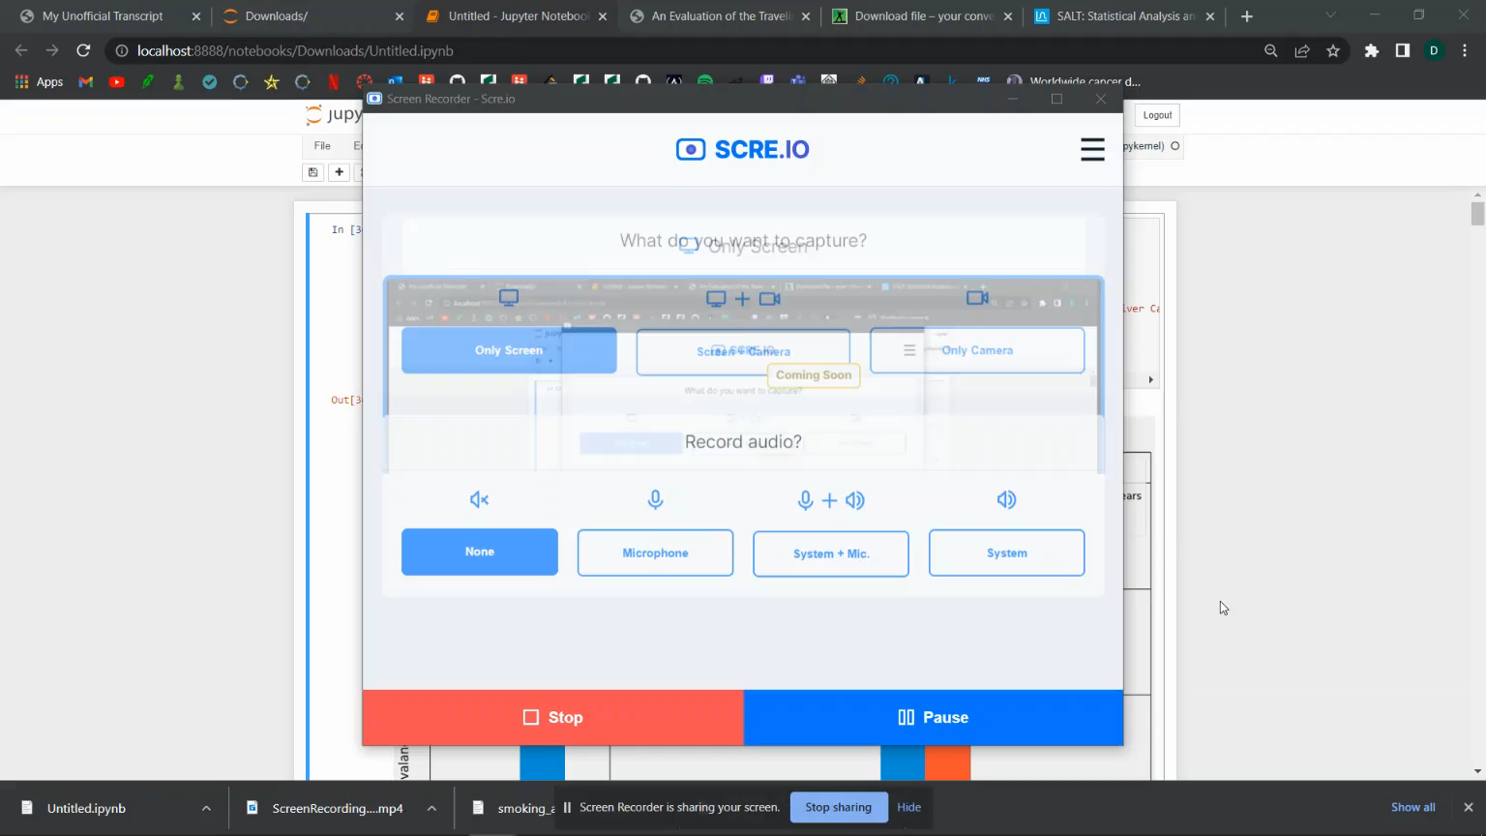
Code: Angel

Slide 30
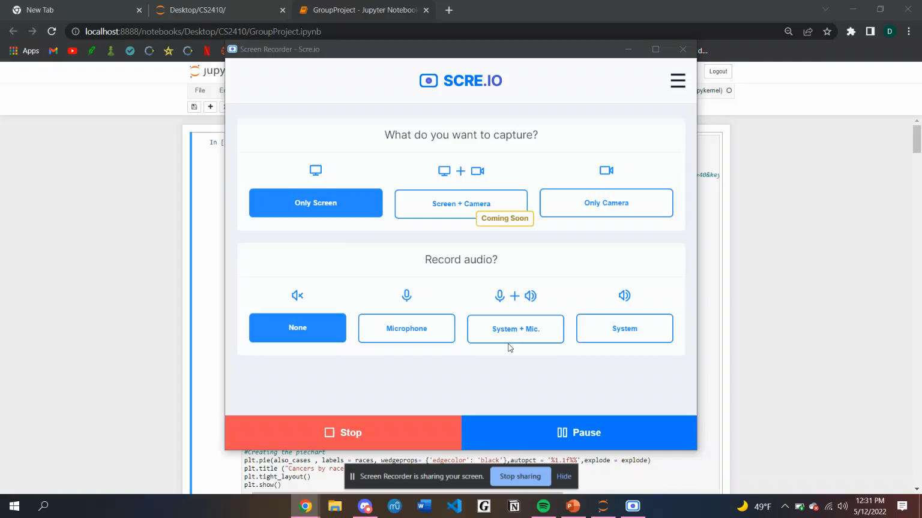
Code: Daniel

Slide 31
Q&A

Slide 32
Datasets
https://gco.iarc.fr/causes/alcohol/tools-bars?mode=2&sex=0&population=900&population_group=4&country=4&continent=0&cancer=40&key=attr_cases&lock_scale=0&nb_results=10&age_group=3&colored=1
https://www.cdc.gov/mmwr/volumes/65/wr/mm6544a3.htm#F1_down
https://www.cdc.gov/mmwr/preview/mmwrhtml/mm5944a2.htm
https://ourworldindata.org/smoking
https://chronicdata.cdc.gov/Alcohol-Related-Disease-Impact/Alcohol-Related-Disease-Impact-ARDI-Application-Al/iz9a-43bv
https://www.cdc.gov/tobacco/campaign/tips/resources/data/cigarette-smoking-in-united-states.html

Slide 33
Work Cited
https://www.cdc.gov/mmwr/volumes/65/wr/mm6544a3.htm#F1_down
https://www.cdc.gov/mmwr/preview/mmwrhtml/mm5944a2.htm
https://www.cdc.gov/tobacco/data_statistics/fact_sheets/health_effects/effects_cig_smoking/

Slide 34
References
“Smoking Rates by Country 2022,” Smoking rates by country 2022. [Online]. Available: https://worldpopulationreview.com/country-rankings/smoking-rates-by-country. [Accessed: 13-May-2022].
“Current cigarette smoking among adults in the United States,” Centers for Disease Control and Prevention, 17-Mar-2022. [Online]. Available: https://www.cdc.gov/tobacco/data_statistics/fact_sheets/adult_data/cig_smoking/index.htm. [Accessed: 13-May-2022].
“What are the risk factors for breast cancer?,” Centers for Disease Control and Prevention, 20-Sep-2021. [Online]. Available: https://www.cdc.gov/cancer/breast/basic_info/risk_factors.htm. [Accessed: 13-May-2022].
“Alcohol-related disease impact (ARDI) application - alcohol-attributable deaths,” Centers for Disease Control and Prevention. [Online]. Available: https://chronicdata.cdc.gov/Alcohol-Related-Disease-Impact/Alcohol-Related-Disease-Impact-ARDI-Application-Al/iz9a-43bv. [Accessed: 13-May-2022].
“U.S. chronic disease indicators: Cancer,” Centers for Disease Control and Prevention. [Online]. Available: https://chronicdata.cdc.gov/Chronic-Disease-Indicators/U-S-Chronic-Disease-Indicators-Cancer/u9ek-bct3. [Accessed: 13-May-2022].
“FASTSTATS - leading causes of death,” Centers for Disease Control and Prevention, 13-Jan-2022. [Online]. Available: https://www.cdc.gov/nchs/fastats/leading-causes-of-death.htm. [Accessed: 13-May-2022].
“Current cigarette smoking among adults in the United States,” Centers for Disease Control and Prevention, 17-Mar-2022. [Online]. Available: https://www.cdc.gov/tobacco/data_statistics/fact_sheets/adult_data/cig_smoking/index.htm. [Accessed: 13-May-2022].
“What is cancer?: Cancer basics,” American Cancer Society. [Online]. Available: https://www.cancer.org/treatment/understanding-your-diagnosis/what-is-cancer.html. [Accessed: 13-May-2022].
H. Ritchie and M. Roser, “Smoking,” Our World in Data, 23-May-2013. [Online]. Available: https://ourworldindata.org/smoking. [Accessed: 13-May-2022].
[“Morbidity and mortality weekly report (MMWR),” Centers for Disease Control and Prevention. [Online]. Available: https://www.cdc.gov/mmwr/preview/mmwrhtml/mm5944a2.htm. [Accessed: 13-May-2022].
2022 April 1, 2022 March 22, and 2022 March 9, “Differences seen in lung tumors of African Americans and whites,” National Cancer Institute, 23-Jan-2018. [Online]. Available: https://www.cancer.gov/news-events/cancer-currents-blog/2018/lung-cancer-biologic-differences-race. [Accessed: 13-May-2022].
“Indicators for chronic disease surveillance — United States, 2013.” [Online]. Available: https://www.cdc.gov/mmwr/pdf/rr/rr6401.pdf. [Accessed: 14-May-2022].
“Alcohol and cancer,” Centers for Disease Control and Prevention, 31-Jan-2022. [Online]. Available: https://www.cdc.gov/cancer/alcohol/. [Accessed: 13-May-2022].
“Cancer and alcohol,” Global Cancer Observatory. [Online]. Available: https://gco.iarc.fr/causes/alcohol/tools-bars?mode=2&sex=0&population=900&population_group=4&country=4&continent=0&cancer=40&key=attr_cases&lock_scale=0&nb_results=10&age_group=3&colored=1. [Accessed: 13-May-2022].
“Worldwide cancer data: World cancer research fund international,” WCRF International, 14-Apr-2022. [Online]. Available: https://www.wcrf.org/cancer-trends/worldwide-cancer-data/. [Accessed: 13-May-2022].
“Real Time World Statistics,” Worldometer. [Online]. Available: https://www.worldometers.info/. [Accessed: 13-May-2022].
“Alcohol Consumption by Country 2022,” Alcohol consumption by country 2022. [Online]. Available: https://worldpopulationreview.com/country-rankings/alcohol-consumption-by-country. [Accessed: 13-May-2022].

